Slide 1
New York Stock Exchange DATA ANALYSIS

Slide 2

Health Care R&D spendings

Slide 3

AGENDA
Introduction to the analysis and its focus on tracking trends in healthcare R&D spending.
Explanation of why the NYSE is an ideal place to monitor these trends ?
Comparison of healthcare R&D spending trends with other sectors.
Identification of unique patterns and differences.
Summarization of key insights from the analysis.

Slide 4
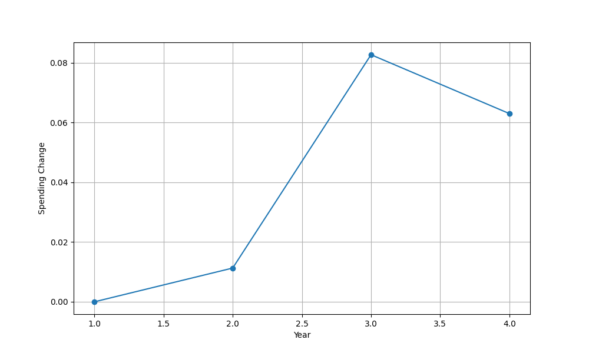
Question no 1
Calculate the year-over-year percentage change for each year over the past
four years.
The line chart illustrates the year-over-year (YoY)
percentage change in Research and Development (R&D) spending
within the health care sector. It reveals the fluctuation in spending
trends over time. The data shows a generally increasing pattern in
R&D spending, with some notable fluctuations. In the most recent
years, there is a noticeable peak in spending, indicating a surge
in R&D investments.

Slide 5
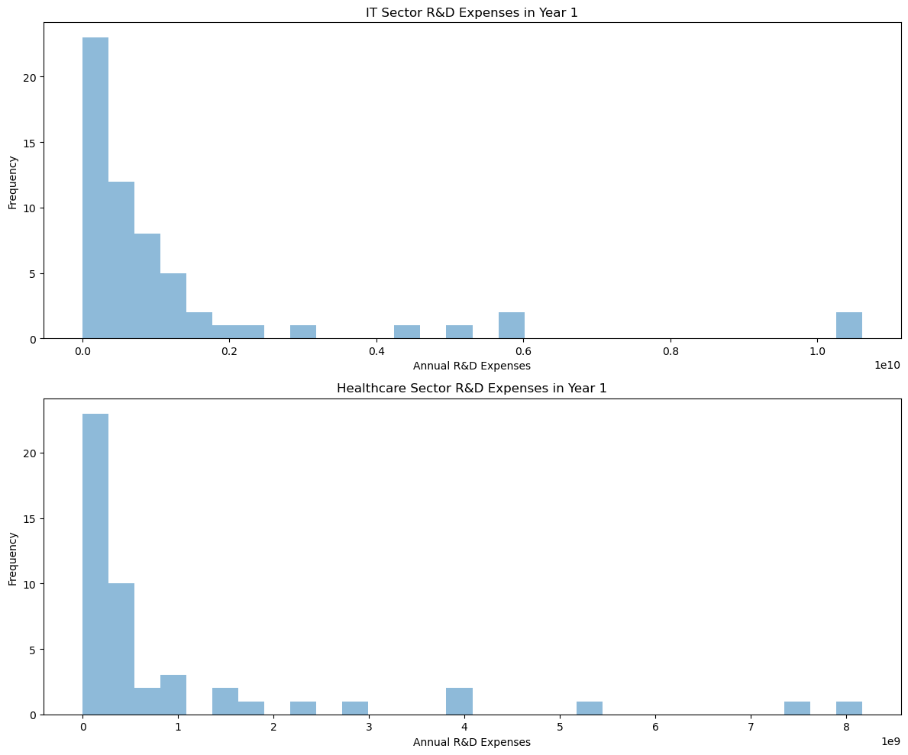
Question no 2
Does the healthcare sector have similar expenditure levels for Research and Development than the IT sector in Year 1?
Here are the histograms for the annual R&D expenses for
Healthcare and IT sector companies reported for all companies in Year 1.
Both distributions are right-skewed or positively skewed
that means, the mean for each is higher than the median.
The mean for healthcare is about $995 million. and for IT is
slightly above at $1.25 billion. However, the median for IT is
double ($590 million) the median for healthcare ($284 million)
The standard deviation for IT is also slightly more ($2.2 billion) and $1.8 billion for healthcare companies).
Introduction to Hospital

Slide 6
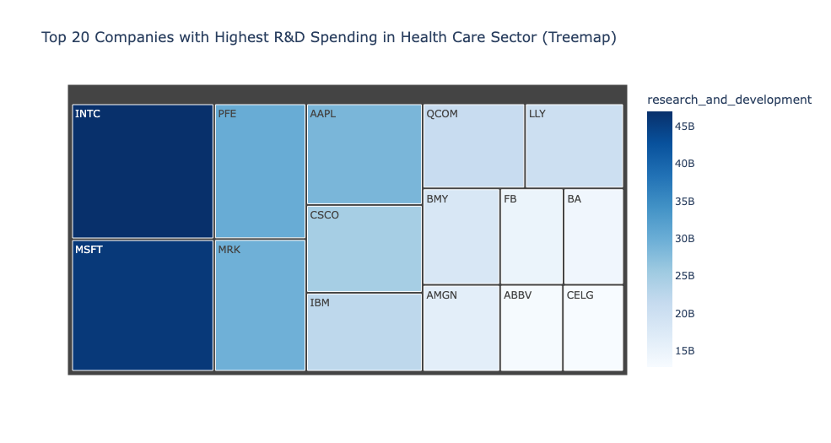
Question no 3
Total R&D Spending By Company In Health Care Sector
5 of the 48 companies form the bulk spending of
70% of the health care sector on R&D.
This is in range from 4 to 8 billion per year. This is
quite elevated from the average of the sector at
around 1 billion per year.
The standard deviation of 1.9 billion is double of
mean representing reasonably large variations in
spend across companies considering outliers.

Slide 7
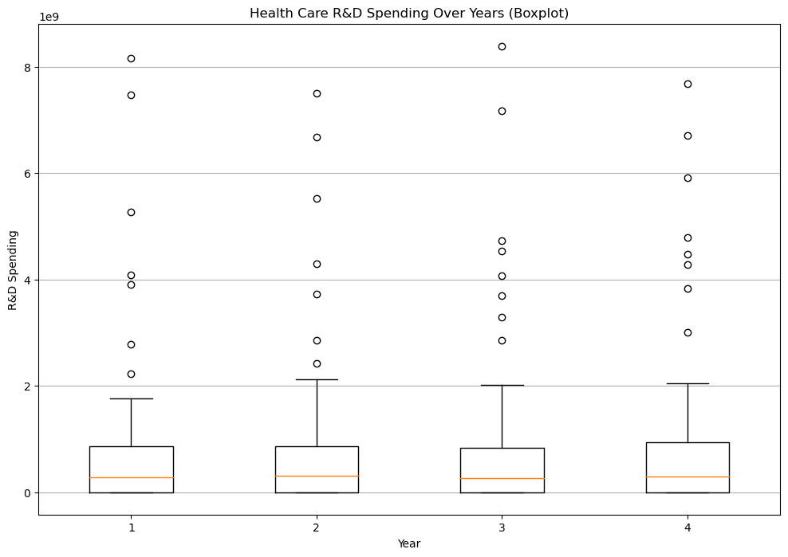
How Health Care R&D spendings have changed over 4 years?
The Box and Whisker Plot with outliers is representing the distribution of year over year spend on R&D in the health care sector.
The mean number of spend over 4 years has a slight increase from 995 to 1159 million dollars.
There is a clear distinction between some companies spending way
more than average spend in the health care sector on R&D. This can be seen from the outliers and right skewness of box plot and an elevated
range of approximately 8 billion.
Question no 4

Slide 8
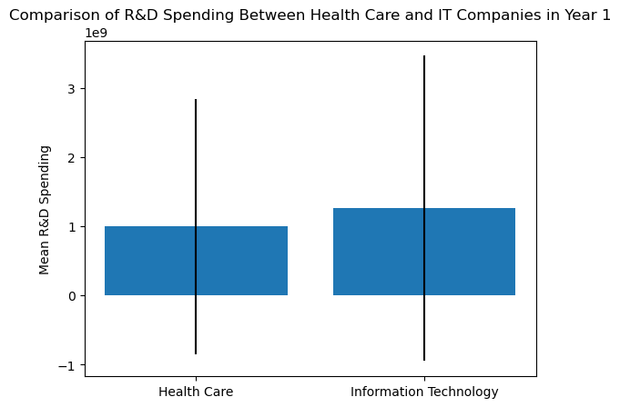
Question no 5
A p-value of 0.5 is relatively high.
When the p-value is 0.5, it indicates that there is a very high probability that the
observed difference in R&D spending between the Health Care and IT sectors
occurred by random chance, and it is not statistically significant.
In practical terms, this suggests that in Year 1, there is no statistically significant
difference in R&D spending between the Health Care and IT sectors based on
the data and statistical analysis performed.
The p-value of 0.5 does not provide
evidence to reject the null hypothesis, which typically states that
there is no difference between the groups being compared.

Slide 9
Conclusion
The NYSE serves as an ideal platform for tracking healthcare R&D spending due to its significant representation of major healthcare corporations
The growth of healthcare R&D spending is good news for the healthcare industry and for patients It means that more
resources are being devoted to developing new and innovative treatments and cures for diseases
This analysis aids investors, healthcare industry stakeholders, and decision-makers in making informed choices and
strategies within the healthcare sector

Slide 10
Thank You

